Slide 1
Smart Irrigation System
Group No. 8

Slide 2
Abstract
Irrigation is the artificial application of water to the land or soil to assist in the growing of agricultural crops. Today water has become one of the most precious resource on the Earth and one of the most important factors in agriculture is water availability. Due to lack of water resources it is essential to find the best methods in irrigation system which can reduce the wastage of water. With the water requirements in irrigation being large, there is a need for a smart irrigation system that can save about 80% of the water. It helps in water conservation by automatically providing water to the plants/gardens depending on their water requirements. It can also prove to be efficient in Agricultural fields, Lawns & Parks.

Slide 3
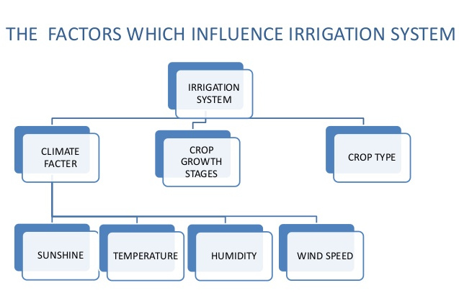

Slide 4
Introduction
In this work we have designed IOT based automated irrigation system for the Indian scenario.
Our system is able to deliver optimal water to the plants based on moisture, light and temperature levels which are obtained through sensors.
The farmer will be able to monitor the parameters through the mobile app which is integrated with cloud storage.
based on soil moisture value land is automatically irrigated by ON/OFF of the motor.

Slide 5
Project Scope
The automated irrigation system is more viable, and can manage irrigation water supply more effectively. It helps to optimize the use of water for irrigation purpose. The water consumption will be reduced with the implementation of soil-moisture based automated irrigation system.
The technique can be used for application of accurate amount of fertilizer, water, pesticide etc. to enhance productivity and excellence.

Slide 6
Project Description
Sensor Based Automates: To measure soil moisture ,luminosity , temperature
GSM Technology: Integration of the GSM module to the Arduino helps us achieve real time updates on the conditions of the plot of land. Any malfunction in the hardware will be sent via message
Wi-Fi Technology: Wi-Fi technology is used to update our soil parameters to the cloud to keep track of the field status using sensors

Slide 7
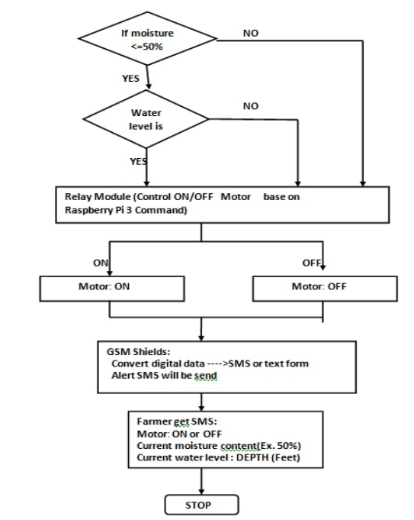

Slide 8
Project Future Scope
Our project can be improvised by taking weather. We can predict the weather and water the plants/crops accordingly. If rain is forecasted, less water is let out for the plants.
A water meter can be installed to estimate the amount of water used for irrigation and thus giving a cost estimation. Furthermore, Wireless sensors can also be used.
Alarm System can be used to alert the Farmer/Land Owner in case of any Unusual activities on the field : this can be obtained by having sensors around to monitor the Field of by installing a live surveillance which can detect unusual movement by image processing.
Providing Different types of Irrigation according to crops: Not limiting ourselves to one type of watering method but using Drip irrigation, sprinklers etc. as different crops need different type of watering system.

Slide 9
References
[1] IoT Based Control and Automation of Smart Irrigation System An Automated Irrigation System Using Sensors, GSM, Bluetooth and Cloud Technology Monica M1 , B.Yeshika2 , Abhishek G.S2 , Sanjay H.A3 ,Sankar Dasiga4
[2] IoT Based Smart Irrigation Monitoring And Controlling System Shweta B. Saraf NBN Sinhgad School of Engineering, Dhanashri H. Gawali NBN Sinhgad School of Engineering

Slide 10
THANK YOU

